Slide 1
Unit 203: Electrical installations technology
Equipotential bonding

Slide 2
Equipotential bonding
BS 7671 defines ‘equipotential bonding’ as:
Electrical connection maintaining various exposed‑conductive‑parts and extraneous‑conductive‑parts at substantially the same potential.
‘Protective equipotential bonding’ is defined as:
Equipotential bonding for the purpose of safety.

Slide 3
Equipotential bonding
BS 7671 further defines ‘exposed‑conductive‑parts’ as:
Conductive part of equipment which can be touched and which is not normally live, but which can become live under fault conditions.
This includes:
steel conduit
steel trunking
steel tray
steel enclosures of wiring systems
metal accessories
metallic equipment.

Slide 4
Equipotential bonding
BS 7671 defines ‘extraneous‑conductive‑parts’ as:
A conductive part liable to introduce a potential, generally earth potential, and not forming part of the electrical installation.

Slide 5
Equipotential bonding
BS 7671 Regulation 411.3.1.2 states that, in each installation, main protective bonding conductors complying with Chapter 54 shall connect to the main earthing terminal extraneous-conductive-parts, including the following:
water installation pipes
gas installation pipes
other installation pipework and ducting
central heating and air conditioning systems
exposed metallic structural parts of the building.

Slide 6
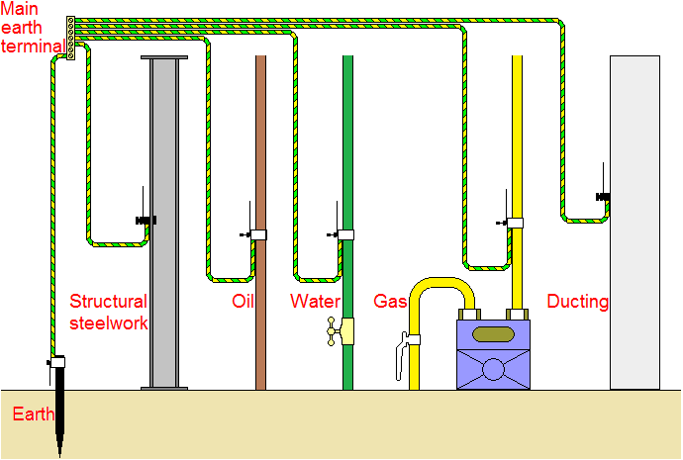
Equipotential bonding

Slide 7
Equipotential bonding
The IET ON‑Site Guide (Section 4.6) states that:
‘The purpose of supplementary equipotential bonding is to reduce the voltage between the various exposed‑conductive‑parts and extraneous‑conductive‑parts of a location during a fault to earth.’

Slide 8
Equipotential bonding
If the installation meets the requirements for BS7671 for earthing and bonding, there is no specific requirement for supplementary equipotential bonding of:
kitchen pipes, sinks or draining boards
metallic boiler pipework
metal furniture in kitchens
metallic pipes to wash hand basins and WCs
locations containing a bath or shower, providing the requirements of 701.415.2 are met.

Slide 9
Equipotential bonding
Important component parts relating to the automatic disconnection of supply to be remembered include:
cpc
main protective bonding conductor
supplementary equipotential bonding conductor
earthing conductor
protective devices
earth electrode.

Slide 10
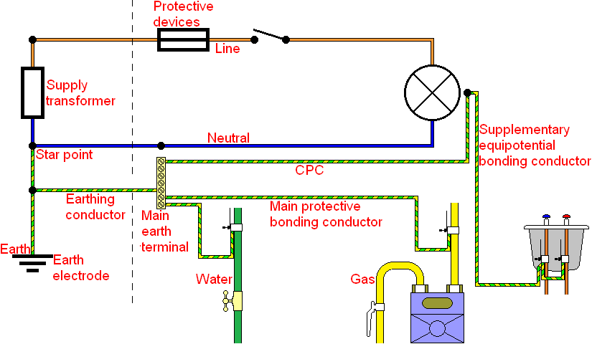
Equipotential bonding

Slide 11
Unit 203: Electrical installations technology
The End

